Slide 1
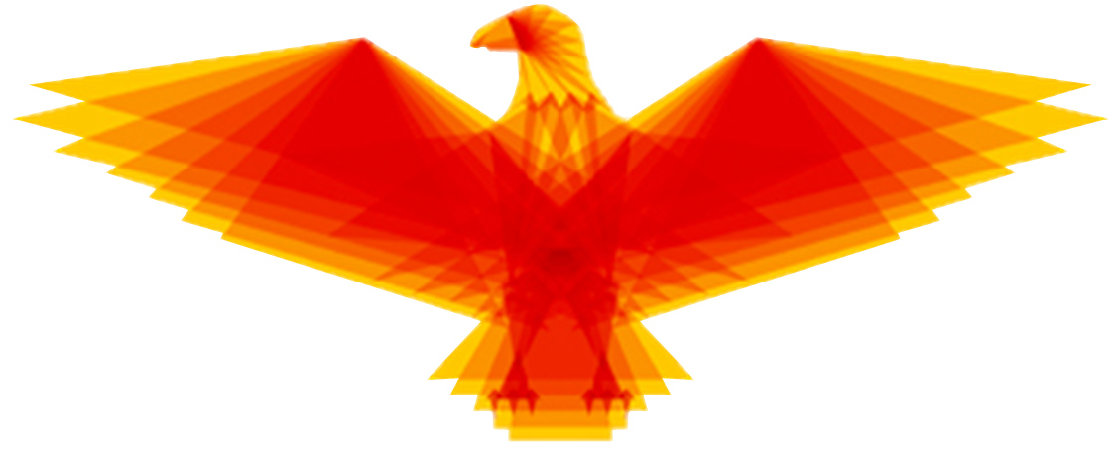

Eagleye: Personnel Tracking in an Augmented Reality Environment
Team: sdmay18-34
Client: Optical Operations LLC
Faculty Advisor: Dr. Daji Qiao
Team Members: Chandler Chockalingam, Victor Da Silva, Josua Gonzales-Neal, Logan Highland, Jason Ramirez, Christopher Stapler

Slide 2

Problem Statement
Personnel and safety issues
No way for construction General Contractors (GCs) to view workers in real time
Lost time and money on megaprojects
9 out of 10 go over budget by 50% (McKinsey & Co.)
$3.3 million a day lost
Current systems do not deliver quantity or quality of data needed for decision making
Leading indicators of safety issues should be more clear to supervisors
Construction: 1 in 5 worker deaths in 2015
Notes:
Add construction site image

Slide 3
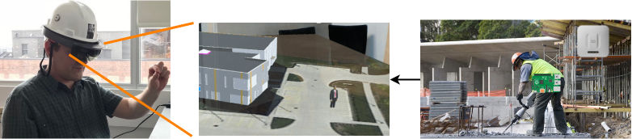
What is Eagleye?
System to track personnel
Viewable in real time from HoloLens
Efficient project management tool
Displays vital data for daily operations
Notes:
High level overview of what Eagleye is

Slide 4
Functional Requirements of System
Worker shall wear token on toolbelt
System uses site wifi
Token uses signal strength (RSSI)
Admin website
Data storage for future playback

Slide 5
Functional Requirements of System
Worker shall wear token on toolbelt
System uses site wifi
Token uses signal strength (RSSI)
Admin website
Data storage for future playback

Slide 6
Functional Requirements of System
Worker shall wear token on toolbelt
System uses site wifi
Token uses signal strength (RSSI)
Admin website
Data storage for future playback

Slide 7
Functional Requirements of System
Worker shall wear token on toolbelt
System uses site wifi
Token uses signal strength (RSSI)
Admin website
Data storage for future playback

Slide 8
Functional Requirements of System
Worker shall wear token on toolbelt
System uses site wifi
Token uses signal strength (RSSI)
Admin website
Data storage for future playback

Slide 9

Nonfunctional Requirements of System
Shall be accurate within 6 meters
Battery life = 1 work day (10 hours)
Real-time, outdoor tracking
Maintainability - Must be maintainable to allow for future development

Slide 10
Nonfunctional Requirements of System
Shall be accurate within 6 meters
Battery life = 1 work day (10 hours)
Real-time, outdoor tracking
Maintainability - Must be maintainable to allow for future development

Slide 11
Nonfunctional Requirements of System
Shall be accurate within 6 meters
Battery life = 1 work day (10 hours)
Real-time, outdoor tracking
Maintainability - Must be maintainable to allow for future development

Slide 12
Nonfunctional Requirements of System
Shall be accurate within 6 meters
Battery life = 1 work day (10 hours)
Real-time, outdoor tracking
Maintainability - Must be maintainable to allow for future development

Slide 13

Deliverables
A real-time tracking system capable of locating users
HoloLens Application that retrieves information from our services and displays a 3D map with personnel tracking
A modular solution that can be easily modified or upgraded
Project demo ready for client to show investors
Notes:
Move to beginning

Slide 14
Deliverables
A real-time tracking system capable of locating users
HoloLens Application that retrieves information from our services and displays a 3D map with personnel tracking
A modular solution that can be easily modified or upgraded
Project demo ready for client to show investors
Notes:
Move to beginning

Slide 15
Deliverables
A real-time tracking system capable of locating users
HoloLens Application that retrieves information from our services and displays a 3D map with personnel tracking
A modular solution that can be easily modified or upgraded
Project demo ready for client to show investors
Notes:
Move to beginning

Slide 16
Deliverables
A real-time tracking system capable of locating users
HoloLens Application that retrieves information from our services and displays a 3D map with personnel tracking
A modular solution that can be easily modified or upgraded
Project demo ready for client to show investors
Notes:
Move to beginning

Slide 17
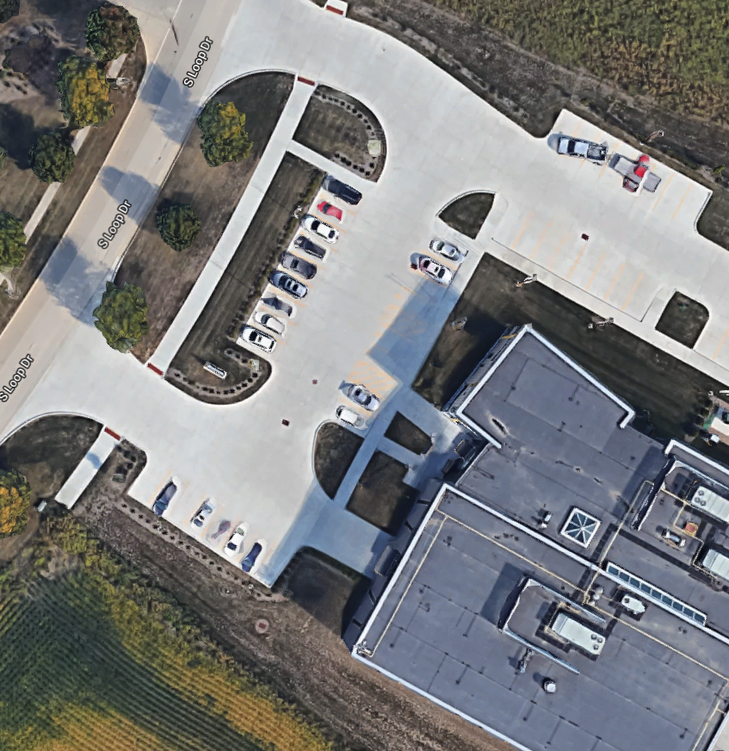
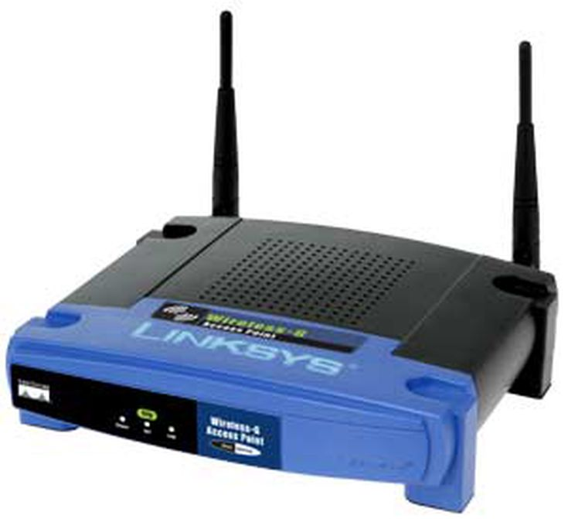
Site Overview
ISU Startup Factory
5 Cisco Outdoor Wireless Access Points

Slide 18
Demo Video

Slide 19




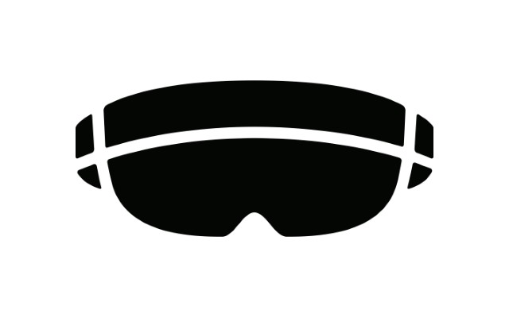
System Specifications and Resource Requirements
User Interface Specification:
HoloLens application displays map with personnel in their respective locations
Hardware Specification:
HoloLens, Raspberry Pi Zero, and Cisco wireless access points (APs)
Software Specification:
Python for the Raspberry Pi and C# for the HoloLens
GCP, Kubernetes, Docker: managing tracking cluster micro-services

Slide 20
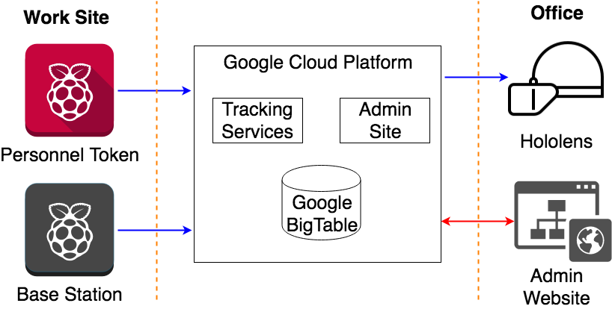
Concept Sketch of Solution
Notes:
Update picture

Slide 21
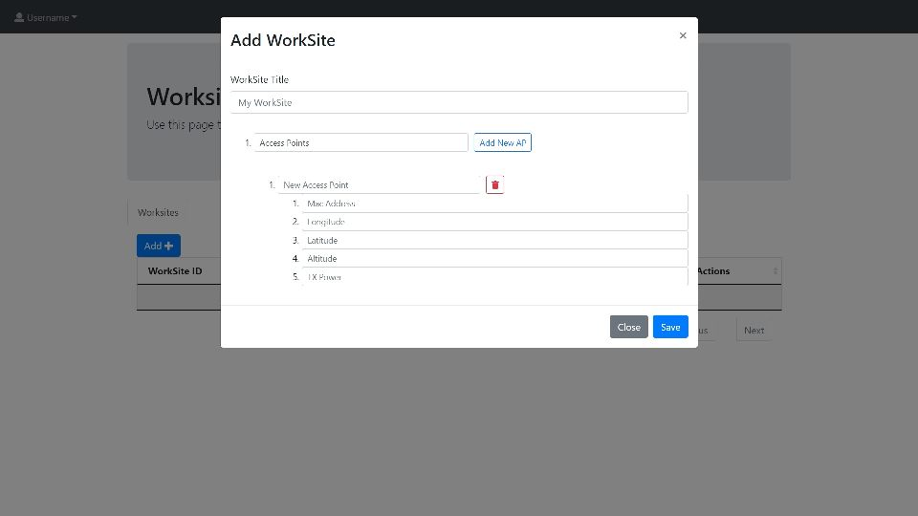
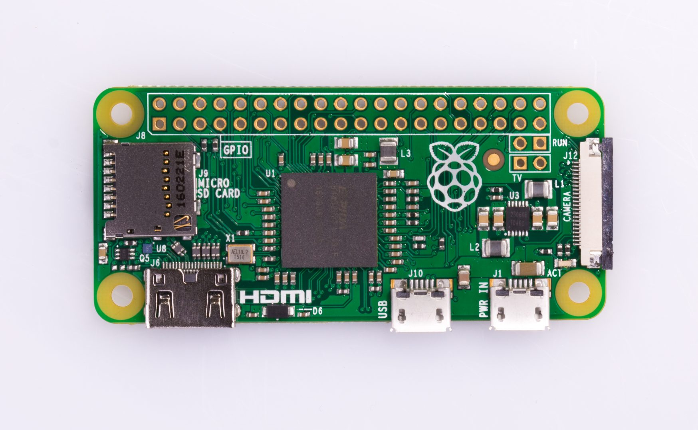
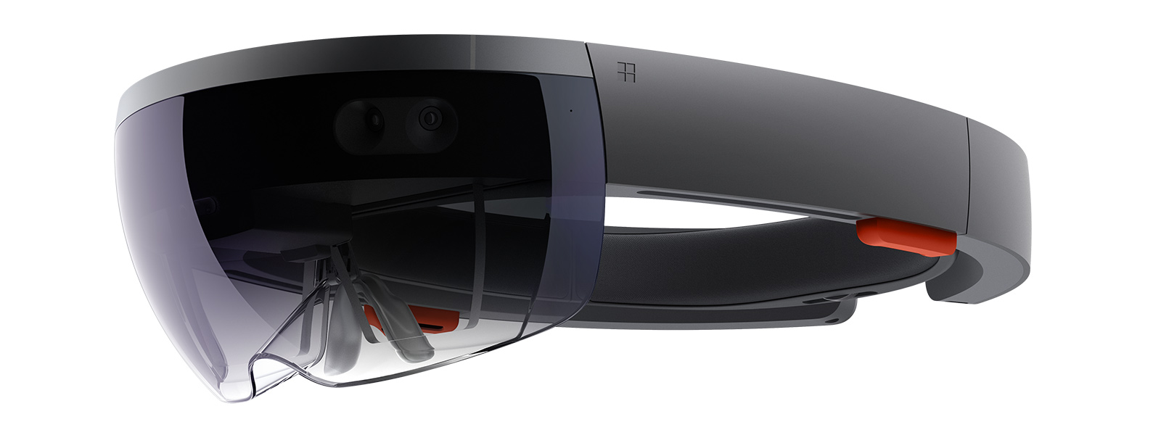
Description of System (Frontend)
Work Site Setup Interface
Sets up a work site with users and AP settings
Tracking Device
Obtains Wireless Tracking Data (WTD): [(Mac Address, RSSI Value)], Time, UserID, WorkSiteID
HoloLens Application
Uses Augmented Reality to virtually place GC’s teams in a virtual work site

Slide 22
Description of System (Backend)
Multilateration Service
Runs triangulation algorithm to create User Location Data (ULD) from WTD
ULD: Latitude, Longitude, Altitude, Time, UserID, WorkSiteID
Socket Service
Sends ULD updates to the general contractor’s view of the work site in real time
Save User Location Data Service
Saves ULD in Databases / Google BigTable
Backend

Slide 23
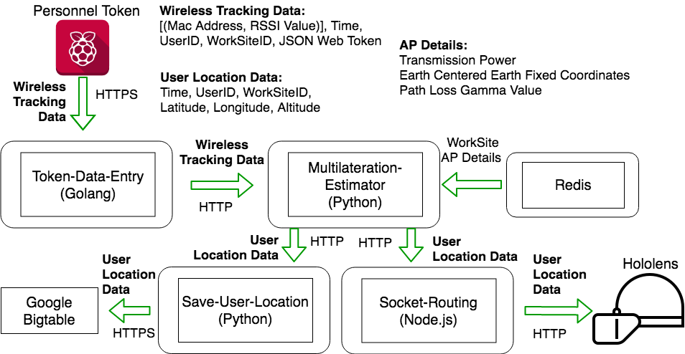
Personnel Tracking Dataflow
Backend

Slide 24
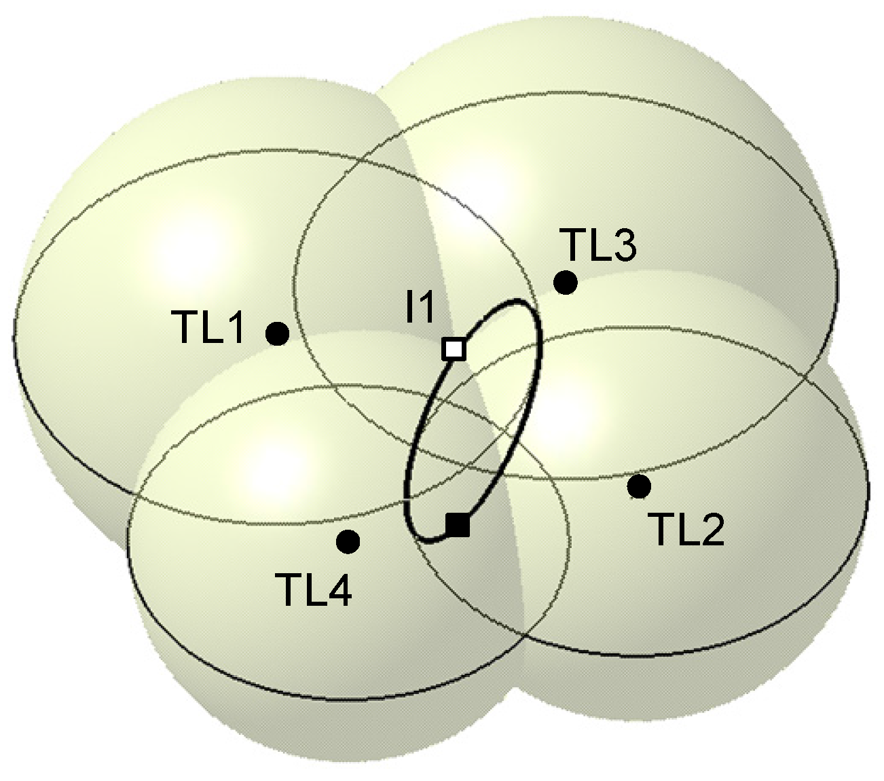
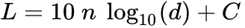
Tracking
RSSI
Transform RSSI (Received Signal Strength Indicator) to Distance via path loss function
d : distance
n: gamma
L: RSSI Value
C: constant
Multilateration
Since we know where the access point is, and the distance away from each access point, we can run multilateration to get the position

Slide 25
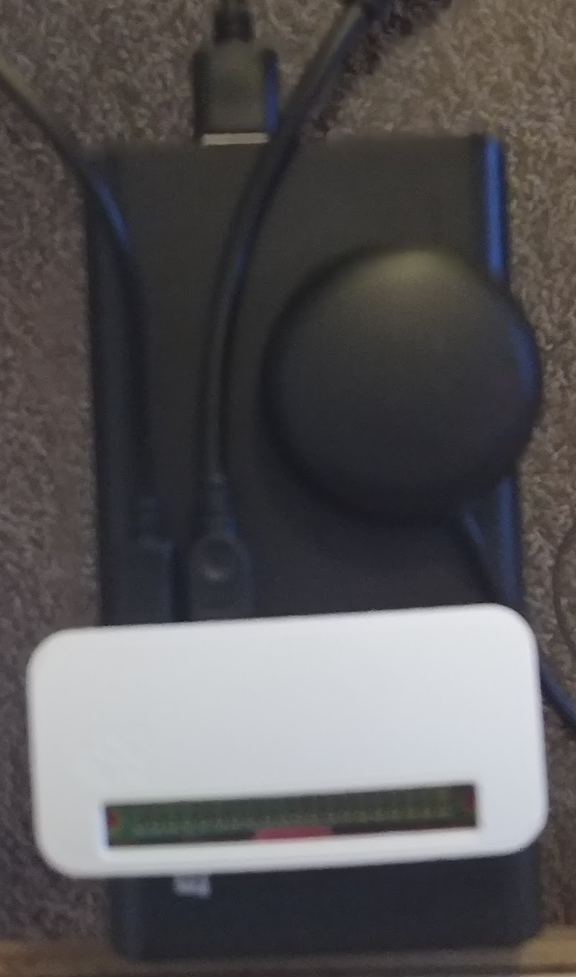
Base Station
Backend
Takes RSSI readings from multiple different locations
Knows its location from GPS
Combines Position and RSSI to get best Path Loss Values from Machine Learning
Sends updates to Base-Correcting Service

Slide 26
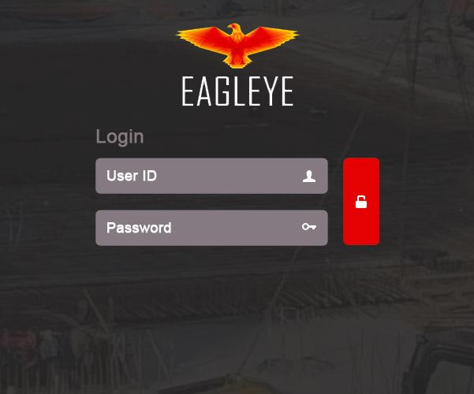
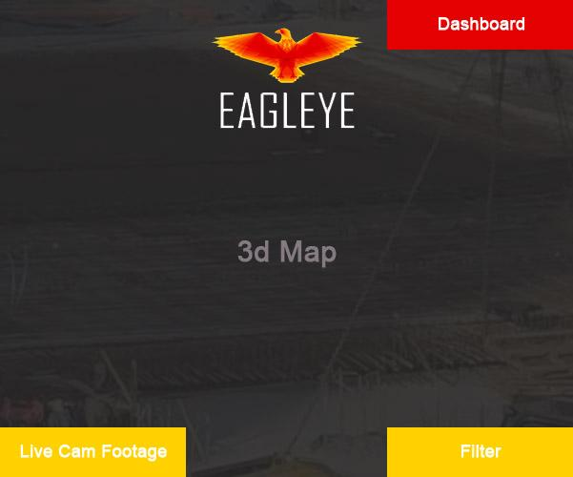
HoloLens Application Overview
Login Screen
Main Application
Dashboard Element
Filter
Dashboard
Live Cam Footage
Map Element
3D model of ISU Startup Factory
3D Model of a construction worker
Notes:
Description of what was completed for the HoloLens, diagrams, etc.

Slide 27
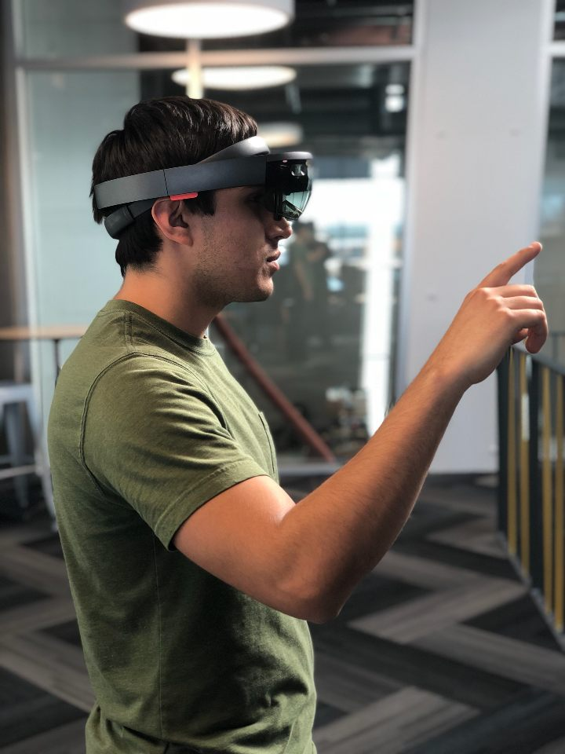
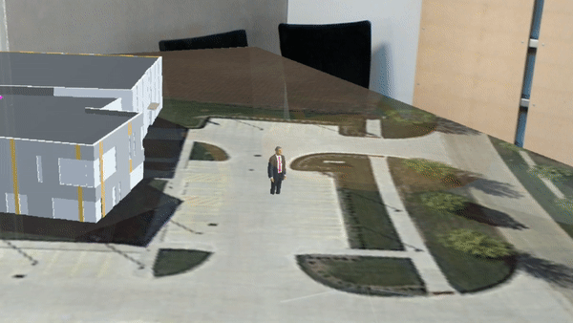
User Interface
A bird's eye view of the environment, with personnel moving within that environment

Slide 28
Similar Existing Product Comparison
GAO RFID Personnel Tracking System
An enterprise solution for tracking using solely RFID.
NAViSEER Precision Personnel Tracking System
This system uses GPS, but the precision goes down in GPS-denied areas.
Buildertrend - The #1 Construction Management Software for home builders and remodelers
Accuware - Indoor and GPS located tracking components (https://www.accuware.com)
Notes:
Move to end
http://gaorfid.com/people-locating-rfid-system/
http://www.afcintl.com/naviseer-precision-personal-tracking-system-from-seer-technology.aspx

Slide 29
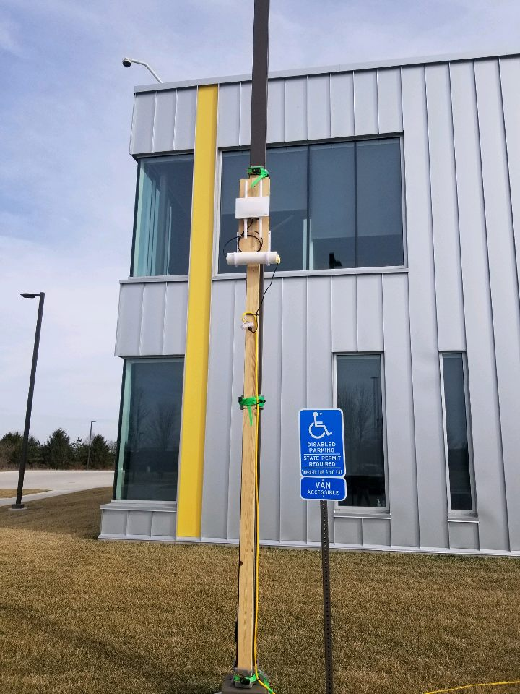
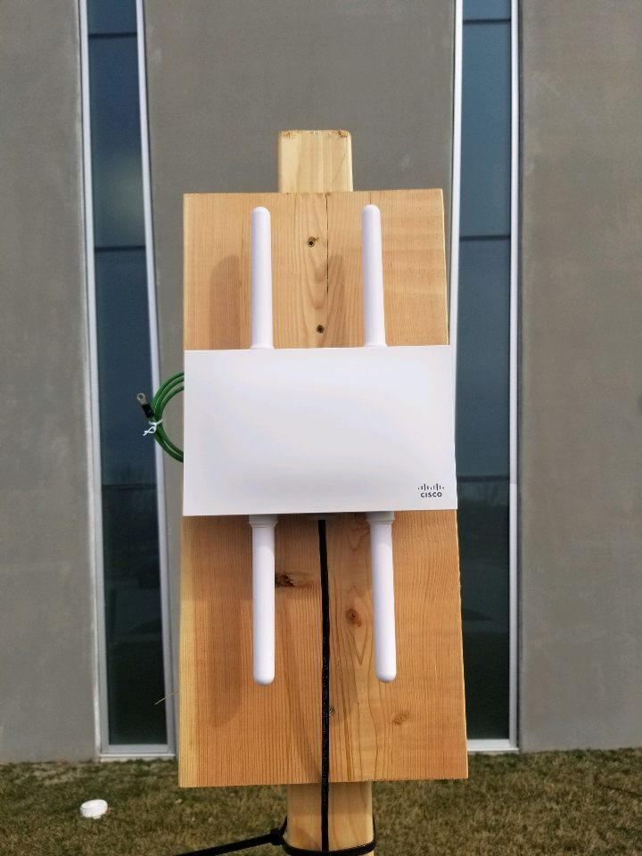
Testing and Evaluation
Software Testing
Unit Tests
Wrote software to simulate service usage
Hardware Testing
Connectivity testing between Pi, Services, and HoloLens
Final Evaluation
Full-system test with all components

Slide 30
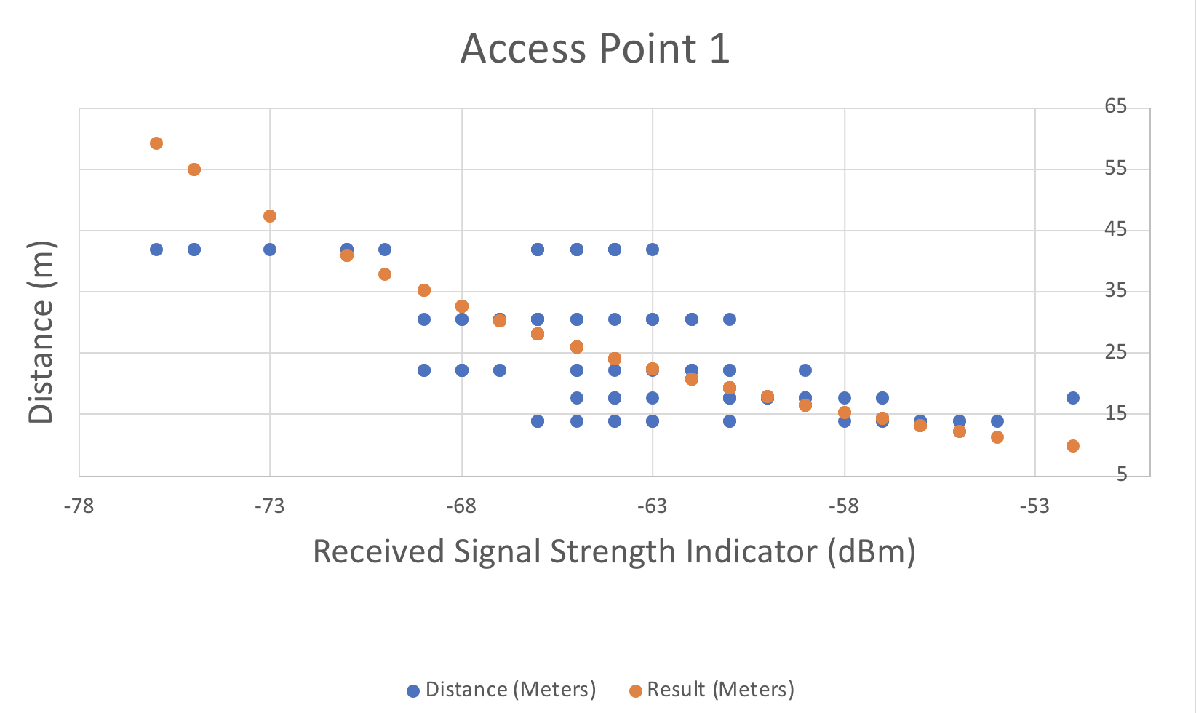
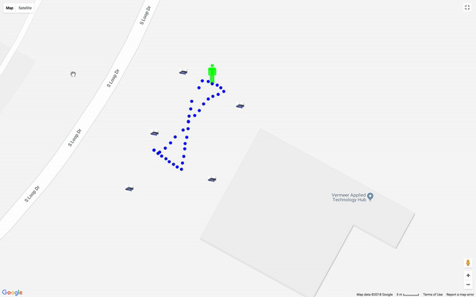
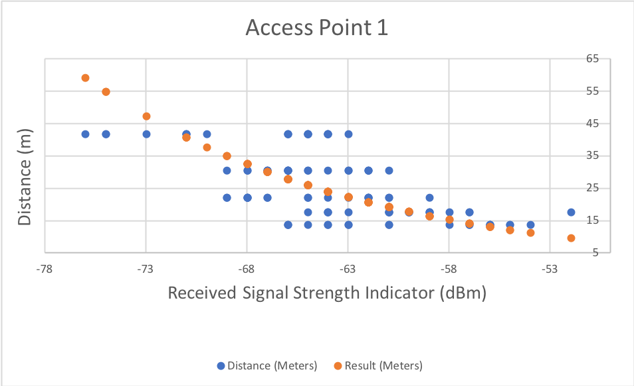
Results of Experimentation and Implementation
RSSI to Distance Tests:
Set AP Location, retrieve data
Simulation Tests:
Simulate based on RSSI To Distance Tests
Full System Test:
Setup:
5 Access points
6 Raspberry Pis, 3 each per person tracked
Accuracy within 6 - 7 meters

Slide 31

Known Risks Associated with Product
Privacy concerns and backlash from workers
HoloLens purchase is required to use system
Competitors with cheaper versions (Smartphone, Cameras)
Sunken cost on Tracking R&D
Training managers on software

Slide 32

Lessons Learned
Project timeline and scope can change drastically due to using new technologies (HoloLens)
Communication is key to making sure client, advisor, and members are in unison
Realizing sunk cost of time and resources and move forward

Slide 33
Conclusion
System to track personnel
Viewable in real time from HoloLens
Major technologies
HoloLens, Raspberry Pi Zero, Cisco wireless access points (APs), GCP
Notes:
Summary
High level diagram

